Slide 1
CS246: Learning To Rank
Junghoo “John” Cho
UCLA

Slide 2
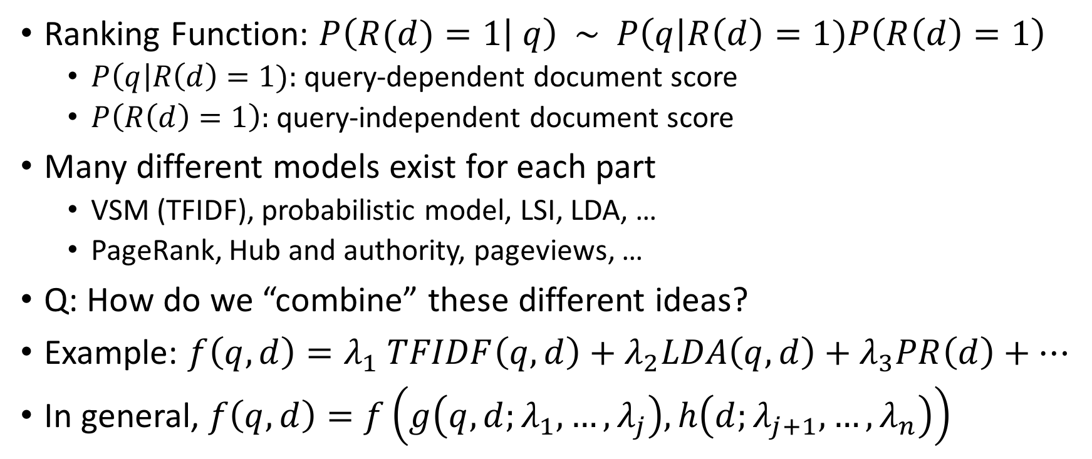
Where We Are
Ranking Function: $P\left(R(d)=1 | q\right) \sim P\left(q\right|R\left(d\right)=1)P\left(R\left(d\right)=1\right)$
  $P\left(q\right|R\left(d\right)=1):$query-dependent document score
  $P\left(R\left(d\right)=1\right):$ query-independent document score
Many different models exist for each part
  VSM (TFIDF), probabilistic model, LSI, LDA, …
  PageRank, Hub and authority, pageviews, …
Q: How do we “combine” these different ideas?
Example: $f\left(q, d\right)=λ_{1} TFIDF\left(q,d\right)+λ_{2}LDA\left(q,d\right)+λ_{3}PR\left(d\right)+…$
In general, $f\left(q, d\right)=f\left(g\left(q,d;λ_{1},…, λ_{j}\right), h\left(d;λ_{j+1}, …,λ_{n}\right)\right)$

Slide 3
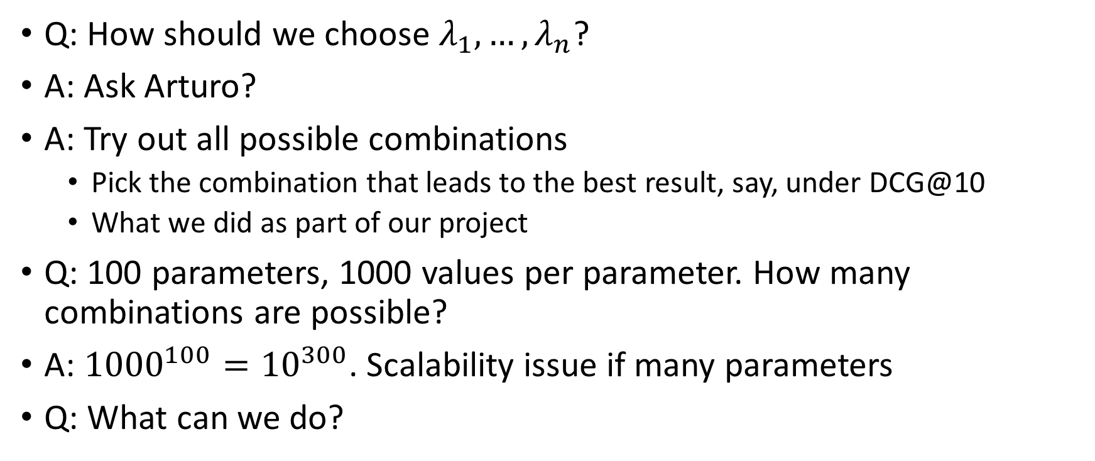
Tuning Ranking Parameters
Q: How should we choose $λ_{1},…, λ_{n}$?
A: Ask Arturo?
A: Try out all possible combinations
  Pick the combination that leads to the best result, say, under DCG@10
  What we did as part of our project
Q: 100 parameters, 1000 values per parameter. How many combinations are possible?
A: ${1000}^{100}={10}^{300}$. Scalability issue if many parameters
Q: What can we do?

Slide 4
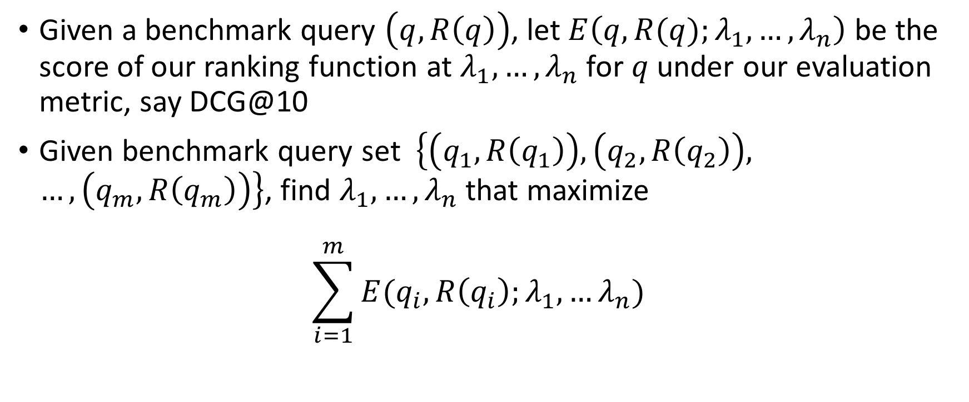
Parameter Tuning as Optimization Problem
Given a benchmark query $\left(q,R\left(q\right)\right)$, let $E\left(q, R(q);λ_{1}, …,λ_{n}\right)$ be the score of our ranking function at $λ_{1}, …,λ_{n}$ for $q$under our evaluation metric, say DCG@10
Given benchmark query set $\left\{\left(q_{1},R\left(q_{1}\right)\right),\left(q_{2},R\left(q_{2}\right)\right), …, \left(q_{m},R\left(q_{m}\right)\right)\right\}$, find $λ_{1},…, λ_{n}$ that maximize
$\sum_{i=1}^{m}{E(q_{i},R\left(q_{i}\right);λ_{1},…λ_{n})}$

Slide 5
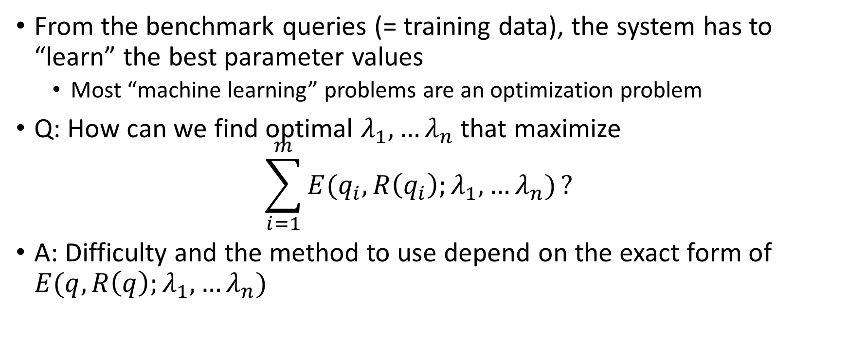
Ranking as Learning Problem
From the benchmark queries (= training data), the system has to “learn” the best parameter values
  Most “machine learning” problems are an optimization problem
Q: How can we find optimal $λ_{1},…λ_{n}$ that maximize
$\sum_{i=1}^{m}{E(q_{i},R\left(q_{i}\right);λ_{1},…λ_{n})}?$
A: Difficulty and the method to use depend on the exact form of $E(q,R\left(q\right);λ_{1},…λ_{n})$

Slide 6
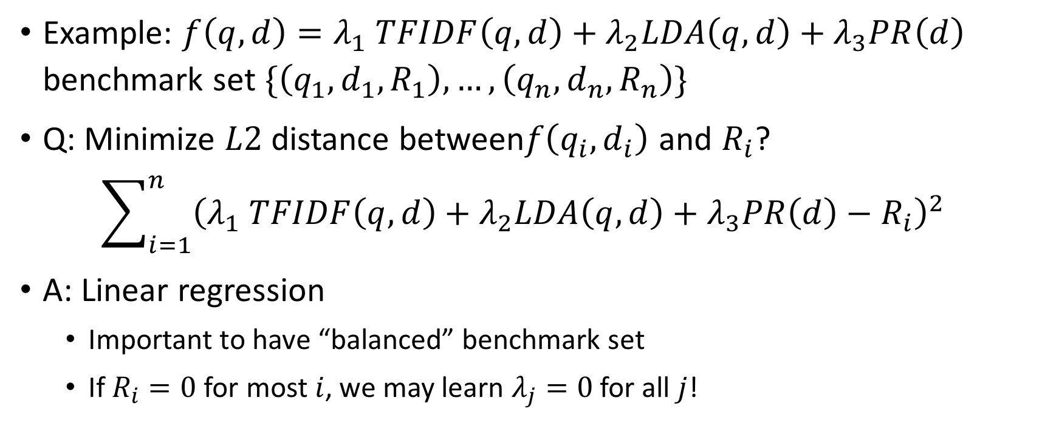
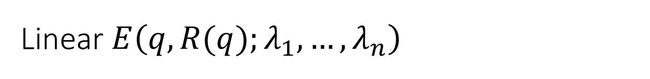
Linear $E\left(q, R(q);λ_{1}, …,λ_{n}\right)$
Example: $f\left(q, d\right)=λ_{1} TFIDF\left(q,d\right)+λ_{2}LDA\left(q,d\right)+λ_{3}PR\left(d\right)$
benchmark set $\{\left(q_{1},d_{1}, R_{1}\right), …, \left(q_{n}, d_{n}, R_{n}\right)\}$
Q: Minimize $L2$ distance between$f\left(q_{i},d_{i}\right)$ and $R_{i}$?
$\sum_{i=1}^{n}{{\left(λ_{1} TFIDF\left(q,d\right)+λ_{2}LDA\left(q,d\right)+λ_{3}PR\left(d\right)−R_{i}\right)}^{2}}$
A: Linear regression
  Important to have “balanced” benchmark set
  If $R_{i}=0$ for most $i$, we may learn $λ_{j}=0$ for all $j$!

Slide 7
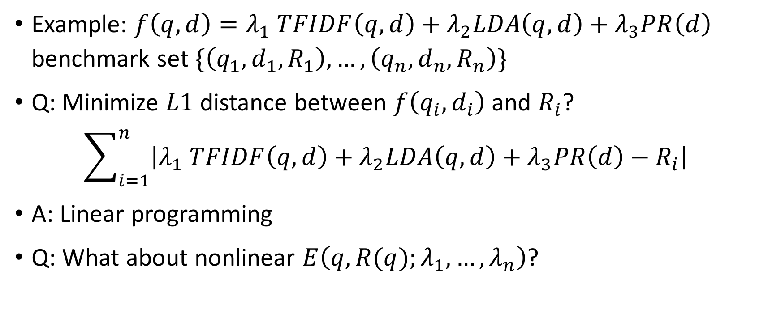
Linear $E\left(q, R(q);λ_{1}, …,λ_{n}\right)$
Example: $f\left(q, d\right)=λ_{1} TFIDF\left(q,d\right)+λ_{2}LDA\left(q,d\right)+λ_{3}PR\left(d\right)$
benchmark set $\{\left(q_{1},d_{1}, R_{1}\right), …, \left(q_{n}, d_{n}, R_{n}\right)\}$
Q: Minimize $L1$ distance between $f\left(q_{i},d_{i}\right)$ and $R_{i}$?
$\sum_{i=1}^{n}{\left|λ_{1} TFIDF\left(q,d\right)+λ_{2}LDA\left(q,d\right)+λ_{3}PR\left(d\right)−R_{i}\right|}$
A: Linear programming
Q: What about nonlinear $E\left(q, R(q);λ_{1}, …,λ_{n}\right)$?

Slide 8
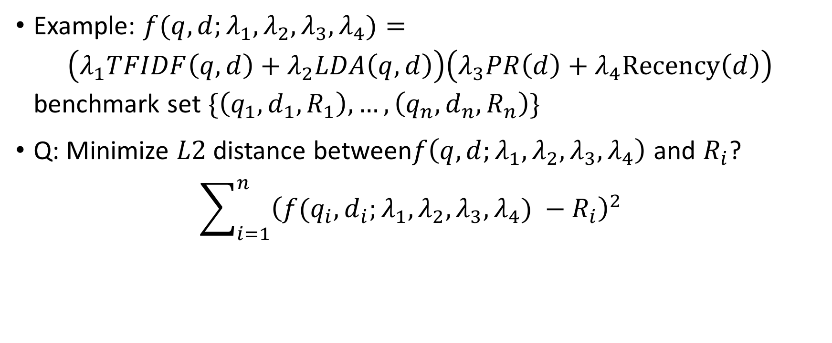

Differentiable $E\left(q, R(q);λ_{1}, …,λ_{n}\right)$
Example: $f(q,d;λ_{1},λ_{2},λ_{3},λ_{4})=$
$\left(λ_{1}TFIDF\left(q,d\right)+λ_{2}LDA\left(q,d\right)\right)\left(λ_{3}PR\left(d\right)+λ_{4}Recency\left(d\right)\right)$
benchmark set $\{\left(q_{1},d_{1}, R_{1}\right), …, \left(q_{n}, d_{n}, R_{n}\right)\}$
Q: Minimize $L2$ distance between$f\left(q,d;λ_{1},λ_{2},λ_{3},λ_{4}\right)$ and $R_{i}$?
$\sum_{i=1}^{n}{{\left(f(q_{i},d_{i};λ_{1},λ_{2},λ_{3},λ_{4}) −R_{i}\right)}^{2}}$

Slide 9
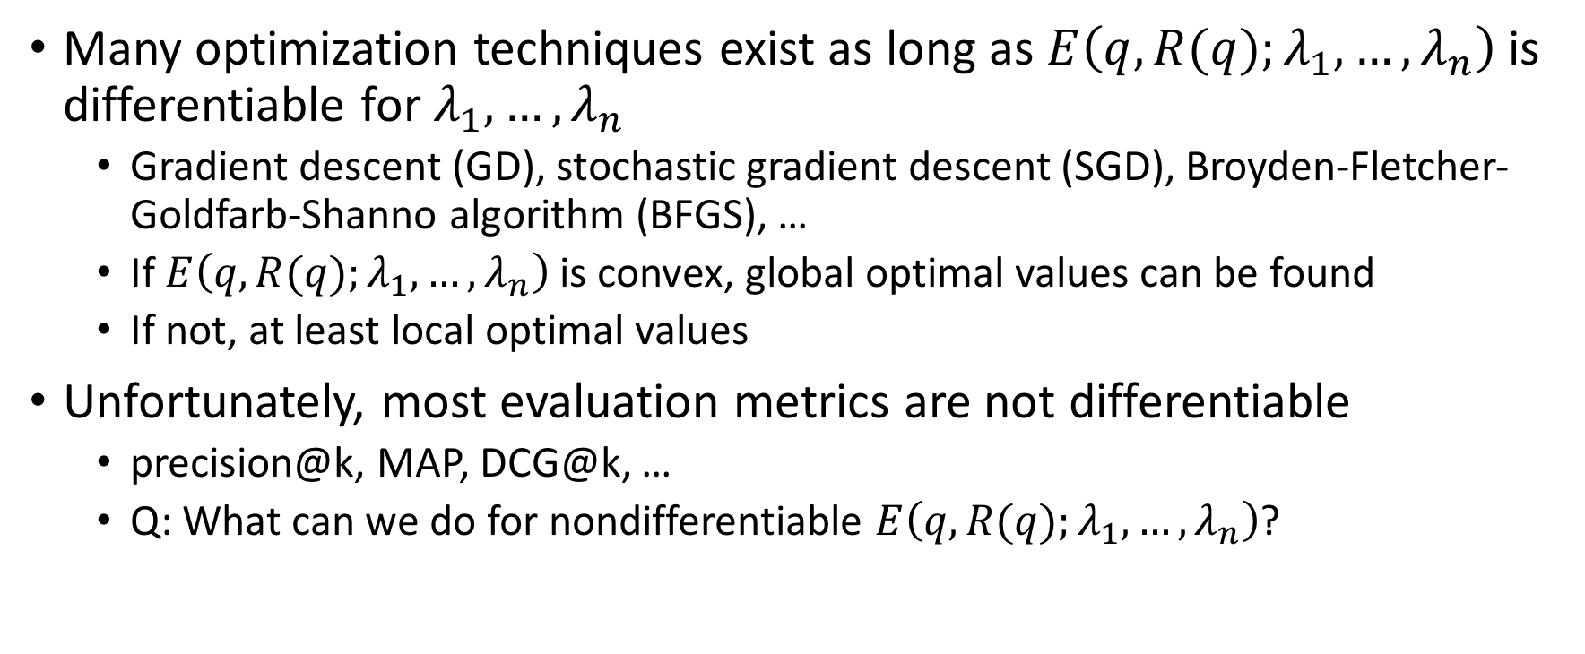
Differentiable $E\left(q, R(q);λ_{1}, …,λ_{n}\right)$
Many optimization techniques exist as long as $E\left(q, R(q);λ_{1}, …,λ_{n}\right)$ is differentiable for $λ_{1}, …,λ_{n}$
  Gradient descent (GD), stochastic gradient descent (SGD), Broyden-Fletcher-Goldfarb-Shanno algorithm (BFGS), …
  If $E\left(q, R(q);λ_{1}, …,λ_{n}\right)$ is convex, global optimal values can be found
  If not, at least local optimal values
Unfortunately, most evaluation metrics are not differentiable
  precision@k, MAP, DCG@k, …
  Q: What can we do for nondifferentiable $E\left(q, R(q);λ_{1}, …,λ_{n}\right)$?

Slide 10
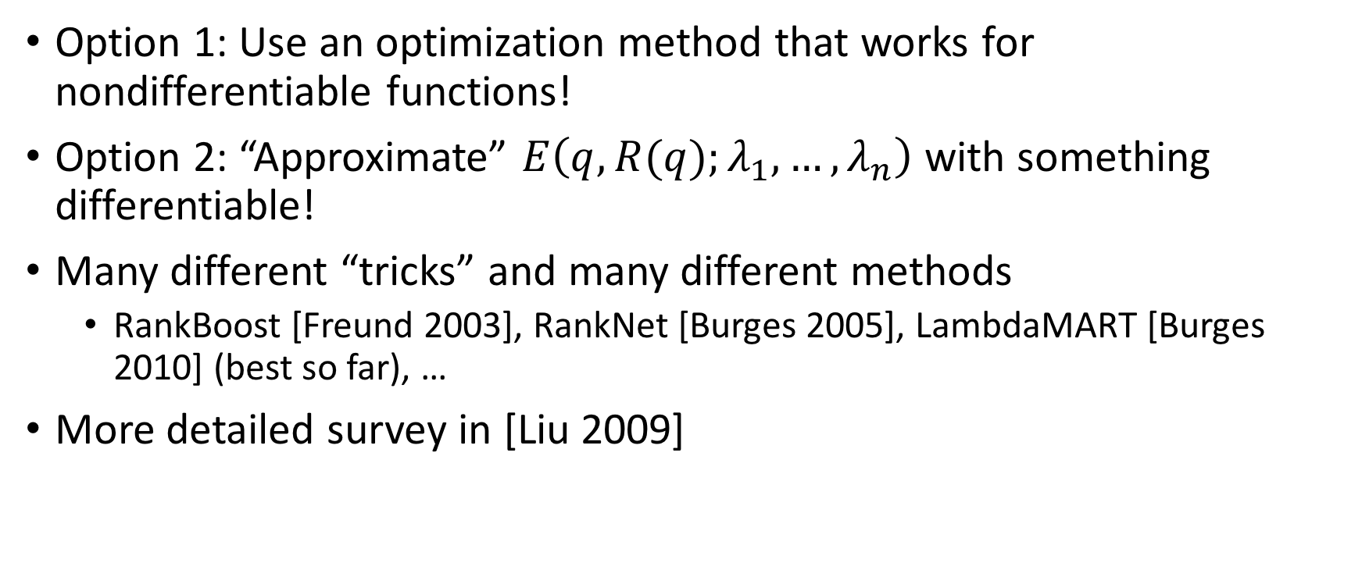

Nondifferentiable $E\left(q, R(q);λ_{1}, …,λ_{n}\right)$
Option 1: Use an optimization method that works for nondifferentiable functions!
Option 2: “Approximate” $E\left(q, R(q);λ_{1}, …,λ_{n}\right)$ with something differentiable!
Many different “tricks” and many different methods
  RankBoost [Freund 2003], RankNet [Burges 2005], LambdaMART [Burges 2010] (best so far), …
More detailed survey in [Liu 2009]

Slide 11
Summary
We need to “tune” parameters in ranking function
Given the large “parameter space,” search engines often apply “machine learning techniques” to find the optimal parameter values
  Challenge of nondifferentiability of common IR metrics
  Importance of constructing a good “training set”: “Junk in, junk out”
Microsoft LETOR project
  Public benchmark dataset for learning-to-rank research

Slide 12
References
[Freund 2003] Yoav Freund, Raj Iyer, Robert Schapire, Yoram Singer: An efficient boosting algorithm for combining preferences in Journal of Machine Learning Research, Vol 4, 2003
[Burges 2005] Chris Burges et al: Learning to Rank using Gradient Descent in ICML 2005
[Burges 2010] Christopher J.C. Burges: From RankNet to LambdaRank to LambdaMART: An Overview in Microsoft Research Technical Report, 2010
[Liu 2009] Tie-Yan Liu: Learning to Rank for Information Retrieval in Foundations and Trends in Information Retrieval, Vol 3(3) 2007

